Slide 1
Testing Basics: Testing Strategies
Boris and Jan

Slide 2
Table of Content
Testing Strategies (Jan)
Applying Strategies to Angular

Slide 3
Example

Slide 4
What to test to make the Product Owner happy?
Functional Testing
Code is a black box
Tests cover business concerns:
getLastName() returns an empty String if no lastname is defined
an email is sent if something goes wrong in a critical part of a process (e.g. „Händleranlage durch das Ratenkaufportal)
Strategies:
Decision Table
Cause-Effect Graphing Techniques

Slide 5
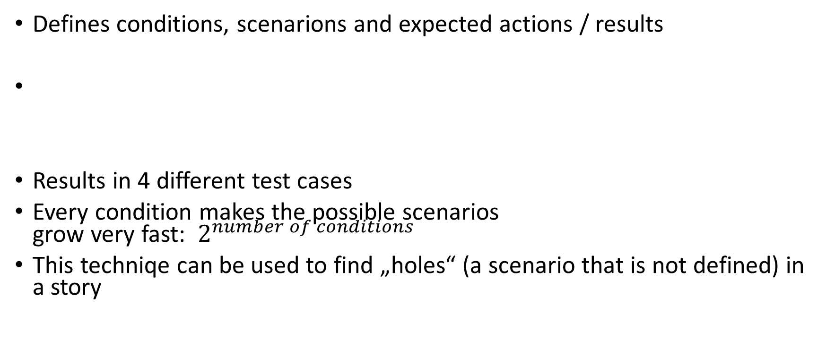
Decision Table
Defines conditions, scenarions and expected actions / results
Results in 4 different test cases
Every condition makes the possible scenarios grow very fast: $2^{number of conditions}$
This techniqe can be used to find „holes“ (a scenario that is not defined) in a story
Condition | Scenario 1 | Scenario 2 | Scenario 3 | Scenario 4
Username | F | T | F | T
Password | F | F | T | T
Result/Action | Error | Error | Error | Success

Slide 6
Cause-Effect Graphing
Define conditions need to be true for an effect/result:
Results in a minimal subset of test cases to trigger every effect
Notes:
2^9 results in 512 different scenarios => hard to maintain the table
https://www.softwaretestinghelp.com/cause-and-effect-graph-test-case-writing-technique/#Writing_Decision_Table_Based_On_Cause_And_Effect_graph
Go from effect to cause (bottom up)

Slide 7
Result: Only 2 Test cases needed to trigger every effect
Username
Password
Not
Not
AND
OR
Login success
Login denied
Notes:
3 Cases needed using the decision table

Slide 8
What to test to make the Technical Lead happy?
Structural Testing
Code is a white box (most of the time)
Tests cover implementation concerns:
Trigger an exception if some input is null
Trim input for password validation
Check for null values
Strategies:
Path coverage using Cyclomatic complexity
Data Flow Testing

Slide 9
Path Coverage using Cyclomatic Complexity
M = E – N + 2P
E = the number of edges of the graph
N = the number of nodes of the graph
P = the number of connected components
Example (next page):
E = 7
N = 6
P = 1
=> M = 6 – 7 + 2 * 1 = 3
3 Testcases are needed to cover every branch

Slide 10
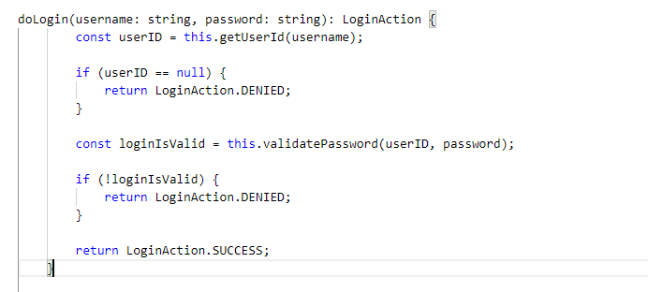

Slide 11
Start
const userID = this.getUserId(username);
END
userID == null
Validate Password
!loginIsValid
Notes:
The example considers getUserId and loginIsValid to constant

Slide 12
Data Flow Testing (Control Flow Testing)
Test possible paths through the program based on control flow and input
How:
Gather all paths
Define inputs for the paths
Write Tests
Example (next page):
Path | canBeLoggedIn | passwordExpired | Expected Output
P1 = 1 -> 2 -> 3 | False | Undefined | DENIED
P2 = 1 -> 2 -> 4 -> 5 | True | True | NEW_PASSWORD
P3 = 1 -> 2 -> 4 -> 6 | True | False | SUCCESS

Slide 13
